Slide 1
CIS 550 – Advanced Machine Learning Group Number: 8
University of Massachusetts, Dartmouth
Date: August 9, 2024

Slide 2
Flight Price Prediction Using Random Forest
Presented by:
Sneha Sonkusare (Roll Number: 43)
Maria Rabel (Roll Number: 1)
Sanjay Dhayalan (Roll number: 40)

Slide 3
Introduction
We aimed to predict flight prices using data.
This helps travelers find better deals on tickets.
Importance of Flight Price Prediction
Knowing flight prices can save travelers money.
Prices change often due to different factors.

Slide 4
Problem Statement
Many factors, like demand and competition, change how airlines set prices.
Travelers find better deals on tickets.
Relevance of the Study
This study aims to build a better model for predicting flight prices.
Better predictions can help travelers save money and plan trips smarter.

Slide 5
Data Collection and Preparation Process
Training Dataset (Data_train):
Includes details about flights, such as the airline, journey date, source, and destination.
Contains additional columns for departure time, arrival time, duration, total stops, extra info, and the ticket price.
Testing Dataset (Test_set):
Contains the same flight details as the training dataset but does not include the ticket price, which we want to predict.

Slide 6
Data Processing
Data Cleaning:
We fixed errors in the dataset to improve accuracy.
Missing values in the Route and Total Stops columns were checked and handled. Columns with null values were dropped.
Descriptive Statistics:
We used descriptive statistics to summarize flight prices, showing their distribution, central tendencies, and spread.
This helps inform decisions about data transformations and modeling techniques.
Exploratory Data Analysis (EDA):
EDA helps us understand the dataset better by visualizing relationships and patterns.
We converted unnecessary columns like Departure Journey into more useful columns, such as Journey Day and Month.
Data Type Conversion:
Object type columns were converted into datetime format for better analysis.
Duration was split into two new columns: Duration Hours and Duration Minutes.

Slide 7
Handling Categorical Data
Types of Categorical Data:
Nominal Data: These are categories with no order, like airline names (e.g., Jet Airways, IndiGo).
Ordinal Data: These categories have a clear order, like ratings (e.g., good, better, best).
Encoding Techniques:
One-Hot Encoding: This creates new columns for each category in nominal data. For example, if we have three airlines, we create three columns, one for each airline, to show if a flight is with that airline (1) or not (0).
Label Encoding: This assigns numbers to ordinal data based on their order. For example
“Non-stop" is replaced with 0
“1 stops" is replaced with 1
"2 stops" is replaced with 2
“3 stops" is replaced with 3
“4 stops" is replaced with 4

Slide 8
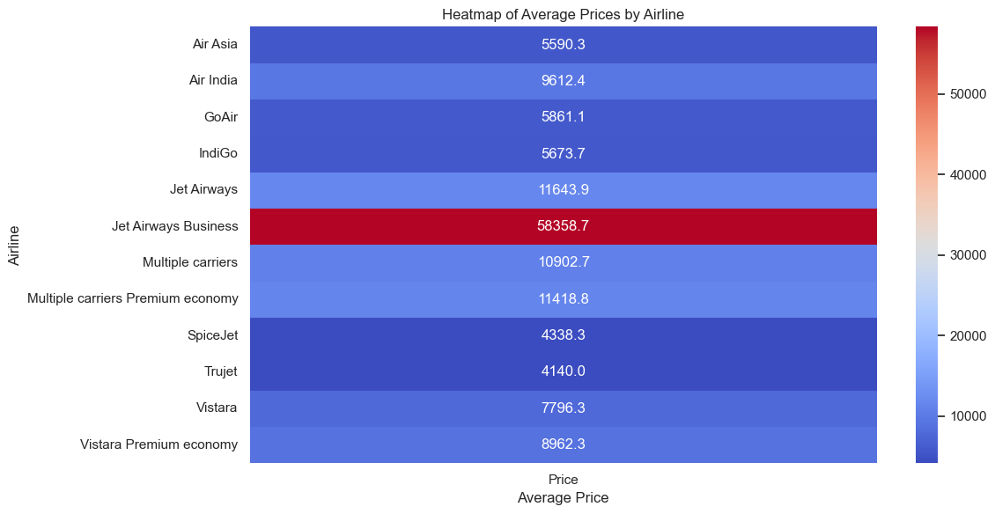
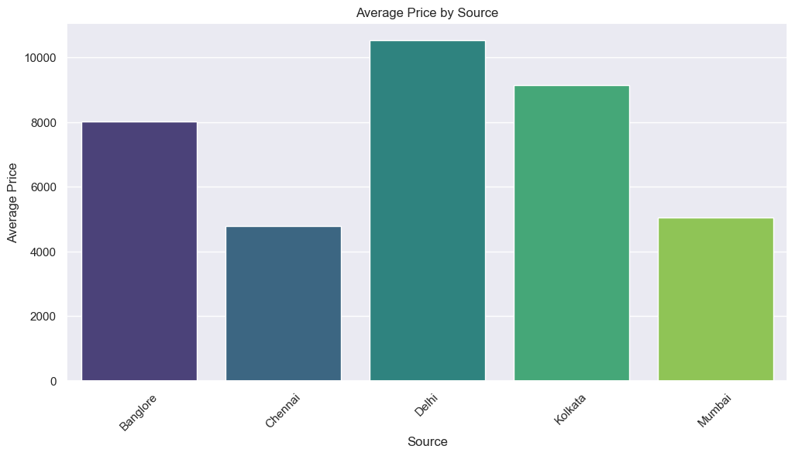
Average Price by airline and source

Slide 9
Data Preprocessing for Test Data
Checking Test Data Info: Reviewed the test dataset to understand its structure and data types.
Checking for Null Values: Examined the test data for any missing values.
Exploratory Data Analysis (EDA):
Extracted day and month from Date_of_Journey and dropped the original column.
Extracted hour and minute from Dep_Time and removed the original column.
Created Duration_hours and Duration_mins columns, dropping the original Duration column.
Dropped unwanted columns to streamline the dataset.
Encoded categorical variables like Source, Destination, and Airline into numerical format.

Slide 10
Feature Selection Methods
Finding Relevant Features
Identify features that closely relate to the target variable (price).
Heatmap
Visual tool showing correlations between features and the target variable.
Darker colors indicate stronger relationships.
Feature Importance
Scores features based on their contribution to predictions.
Higher scores mean more important features.
SelectKBest
Selects top K features using statistical tests.
Helps identify relevant features for better model performance.

Slide 11
Features Used in Prediction
Features Used in Prediction
Airline, Source, Destination, Departure Tim, Duration, Number of Stops
Target Variable
Price: The ticket price we want to predict.
Data Shape and Columns
Data Shape: 10,682 rows and 30 columns.
Key Columns: Total Stops, Price, Journey Day, Journey Month, and encoded airline and location columns.
Feature Matrix (X)
X includes selected columns used for predicting flight prices.

Slide 12
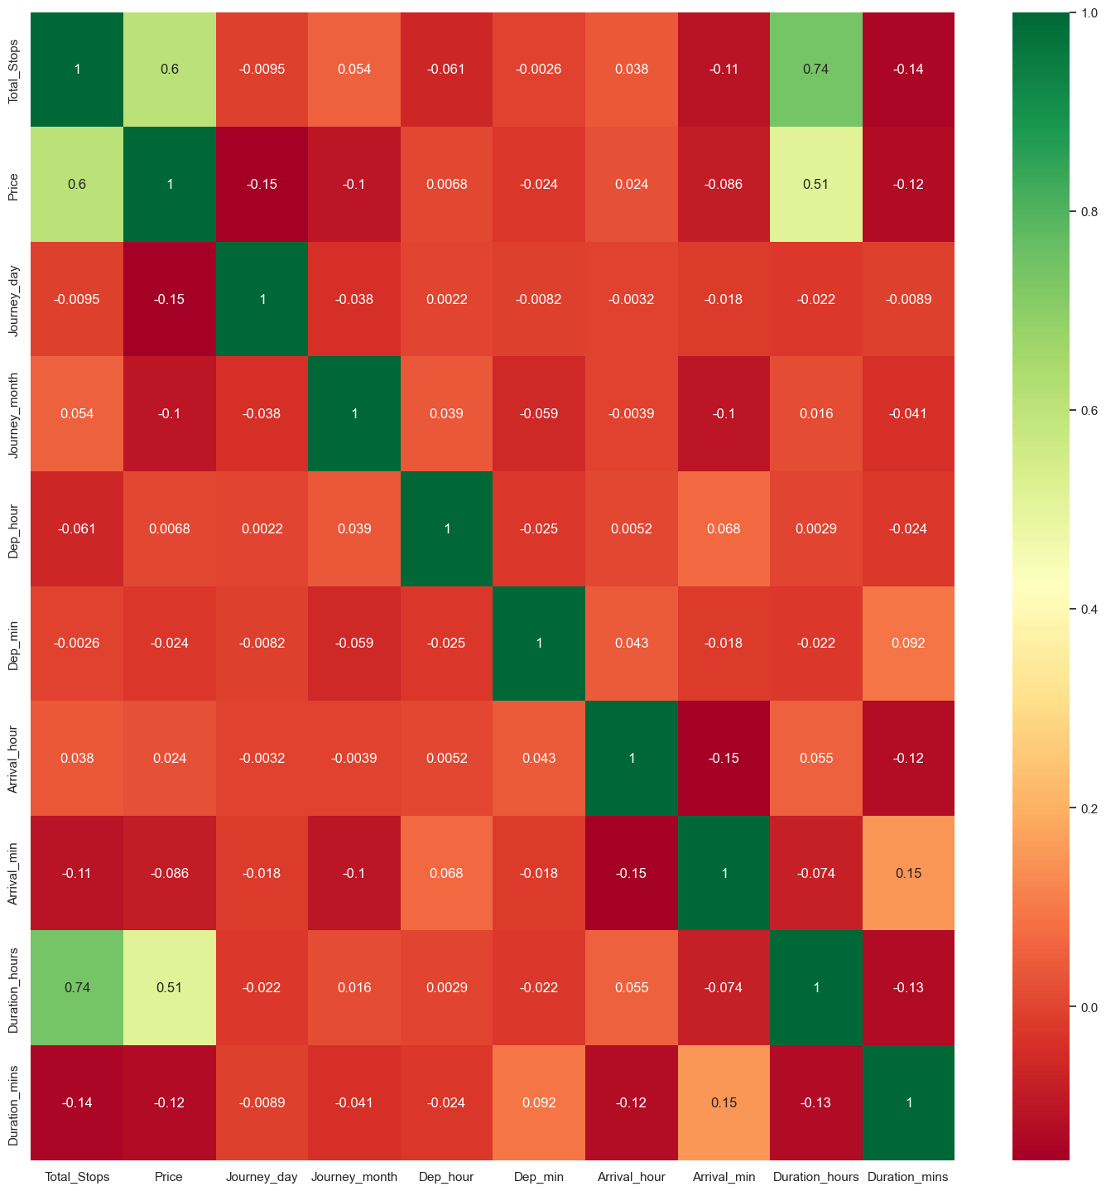
Why We Use Heatmaps in Flight Price Prediction
Visualizing Relationships: Heatmaps visually show correlations between features, making it easy to identify relationships with the target variable (flight price).
Identifying Strong Correlations:
1. Duration Hours and Total Stops: Strong positive correlation (0.74) indicates that longer flights often have more stops.
2. Total Stops and Price: Moderate negative correlation (e.g., -0.75) suggests that flights with more stops tend to have lower prices.
Guiding Feature Selection: Correlations help identify important features for modeling. Features with strong relationships to price can enhance prediction accuracy.

Slide 13
ExtraTreesRegressor Model
ExtraTreesRegressor is a machine learning algorithm specifically designed for regression tasks.
Using the ExtraTreesRegressor allows you to effectively gauge which features are most important for predicting flight prices. By interpreting the feature importance scores and visualizing them, you can make informed decisions about which features to include in your predictive models for better performance.
Example of Important Features
In flight price prediction, important features might include:
Duration Hours: Longer flights might cost more due to higher fuel expenses.
Airline: Different airlines have different pricing strategies.
Journey Day: Some days (like holidays) have higher demand, leading to higher prices.
Total Stops: Flights with fewer stops are usually more expensive for convenience.

Slide 14
Random Forest Model
A Random Forest Model is a type of ensemble learning method used in machine learning for both classification and regression tasks. It operates by creating a forest of multiple decision trees during training and outputs the mode or mean prediction of the individual trees.
Key Features:
Ensemble Method: Combines predictions from multiple trees to improve accuracy and reduce overfitting.
Decision Trees: Each tree is trained on a random subset of the data and features, allowing for diversity in the predictions.
Robustness: Handles large datasets and maintains performance even with missing values.

Slide 15
Steps to Fit the Model
Split the Dataset
Divide data into training and testing sets.
Example: Use 80% for training and 20% for testing.
Model Training:
Fitting a model involves training it using a set of input features (independent variables) and the corresponding target variable (dependent variable). In our case, we are training the Random Forest model to predict flight prices based on various features like airline, duration, and number of stops.Learning from Data: During fitting, the model learns the relationships and patterns within the training data. It adjusts its internal parameters to minimize prediction errors.
Making Predictions
Once the Random Forest model is trained (fitted) using the training dataset, the next step is to use it to make predictions on new, unseen data, specifically the test data. This is crucial for assessing how well the model performs in real-world scenarios.

Slide 16
Evaluating Model Performance
After we make predictions, we need to see how well our model is doing. RMSE (Root Mean Squared Error) is a popular way to measure this.
Key Points:
RMSE: This number tells us the average difference between the actual prices and the predicted prices. A lower RMSE means our model is doing a better job because it shows the predictions are closer to the real values.
Training Score: This score shows how well the model fits the training data. It’s measured using R² (coefficient of determination), which ranges from 0 to 1. A score close to 1 means the model learned the training data well.
Testing Score: This score checks how the model performs on new data (test data). A good testing score shows that the model can make accurate predictions on data it hasn't seen before, which means it’s not just memorizing the training data.

Slide 17
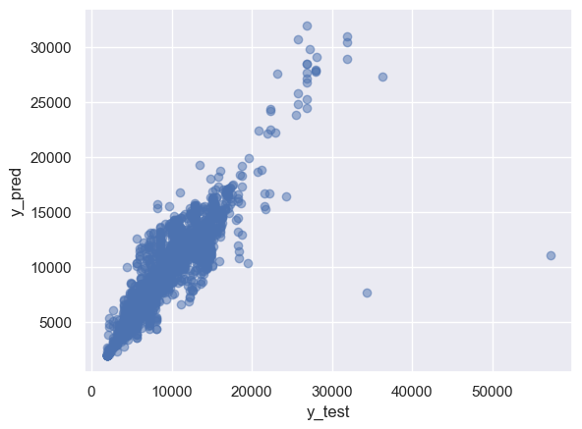
Residuals: Residuals are the differences between the actual flight prices (what they really are) and the predicted prices (what our model estimates). Mathematically, it’s calculated as:
Plot Residuals: To understand how well our model is performing, we can plot these residuals. In a good model, the residuals should be close to zero, meaning that the predictions are very close to the actual values. This helps us see if there are any patterns in the errors.
Scatter Plot:
We can create a scatter plot to visually compare the actual prices (y_test) with the predicted prices (y_pred).
Each point on the plot represents a flight.Ideal Situation: In an ideal scenario, the points should cluster around a straight line (y = x). This line indicates that the predicted prices match the actual prices closely.

Slide 18
Error Metrics Overview
Mean Absolute Error (MAE): Measures the average absolute difference between actual and predicted values. Example: MAE of $1183.93 indicates predictions are, on average, $1183.93 away from actual prices.
Mean Squared Error (MSE): Calculates the average of the squared differences between actual and predicted values. Example: MSE of $4,402,946.85 highlights significant deviations.
Root Mean Squared Error (RMSE): The square root of MSE, providing average prediction error in original units. Example: RMSE of $2098.32 means the average error is about $2098.32.
Normalized RMSE: RMSE divided by the range of the target variable, indicating error as a percentage of the range. Example: Normalized RMSE of 0.0269 means average error is about 2.69% of the target range.
R² Score: Explains the variance in actual values by the model's predictions. Example: R² of 0.7984 means the model explains about 79.84% of the variance.

Slide 19
Conclusion
Conclusion Based on Evaluation Metrics
MAE (~1293.12): On average, the model's predictions are about Rs. 1293 off from the actual flight prices. This shows a fair level of accuracy but suggests there's room for improvement.
MSE (~3921268.69): This high value indicates that the model has some large errors in its predictions, meaning it struggles with certain cases.
RMSE (~1980.22): The average prediction error is about Rs 1980.22. While this tells us the model does reasonably well overall, there are significant errors in some predictions.

Slide 20
Questions and Answers

